Slide 1
Fast Multiplication Algorithm for Three Operands
(and more)
Esti Stein
Dept. of Software Engineering, Ort Braude College
Yosi Ben-Asher
Dept. of Computer Science, Haifa University

Slide 2
The Goal
Accelerating the execution time of running programs, by reducing the time of basic operations, such as multiplication.

Slide 3
Multiplication is heavily used in
Multimedia
Graphics
Radar equipment
Cryptology
and more..

Slide 4
Why multiplication is a Complex problem
Given two integers a,b ( n digits each)
  a × b = a + a + .. + a ( b times)
a × b using Long multiplication:
  To multiply two numbers with n digits, the time complexity of multiplying two n-digit numbers using long multiplication is Θ(n²)

Slide 5
Booth - The main algorithm used for multiplication:
Consider the following multiplication:
98765 * 9999
Four mults and adds are needed to compute the product.
The easy way:
98765 * 9999 =
98765 * (10000 – 1) = 98765 * 10000 – 98765

Slide 6
Booth Algorithm - explanation
An efficient way to multiply two signed binary numbers expressed in 2's complement notation :
Reduces the number of operations by relying on blocks of consecutive 1's
Example:
Y × 00111110 = Y × (2⁵+2⁴+2³+2²+2¹).
Y × 00111110 =Y × (01000000-00000010) = Y × (2⁶-2¹). One addition and one subtraction

Slide 7
Booth algorithm - example

Slide 8
E-Booth for three multiplicands
When multiplying two numbers, the multiplicand is shifted i times and added, if the ith bit of the multiplier is equal to '1'.
When multiplying three numbers, the multiplicand is shifted k times and added, if the jth bit of one multiplier is equal to '1' and the (k-j)th bit of the second multiplier is also equal to '1' .

Slide 9
E-Booth (the idea - 1)
Let A = 0110 (6), X = 0011 (3), Y=0001 (1)
A = (1000–0010)
X = (0100-0001)
A⋅X ⋅Y = (1000–0010) ⋅ (0100-0001) =
(00100000-00001000-00001000+00000010)⋅Y
  Y is shifted to bit 1 and added (denoted by 1⁺)
  Y is shifted to bit 3 and subtracted (denoted by 3⁻)
  shifted to bit 3 and subtracted (3⁻)
  shifted to bit 5 and added (denoted by 5⁺).
This phase is building the vector

Slide 10
E-Booth (the idea - 2)
Let A = 0110 (6), X = 0011 (3), Y=0001 (1)
(00100000-00001000-00001000+00000010)⋅Y
Y is subtracted twice at location 3. This equals to subtracting Y once at location 4.
This brings us to consider simplifications (reductions), before applying add/subtrat Y.
In this example we will end up with:
(00100000-00010000+00000010)⋅Y, and calculate

Slide 11
E-booth – the algorithm (3)
Let Y, X and A be three n-bit integers
A – Primary multiplier
X – Secondary multiplier
Y – Multiplicand
Transform X and A to vectors VX, VA by applying:
VX= φ ; VA= φ; and let '◦' be the concatenation operation
In parallel for i = 1..n do begin {* apply the same to VA *}
(a) if X_{i+1}X_{i}X_{i-1}="010" then VX = "i⁺“◦VX
(b) if X_{i}X_{i-1}="10” then VX = "i⁻"◦VX
(c) if X_{i}X_{i-1}="01" then VX = "(i+1)⁺"◦VX
End;

Slide 12
E-Booth - example (4)
Y=22=00010110 (multiplicand).
X=54=00110110 (multiplier).
A=29=00011101 (primary multiplier).
X = 0 0 1 1 0 1 1 0 A = 0 0 0 1 1 1 0 1
VX = (7⁺ 5⁻ 4⁺ 2⁻) and VA = (6⁺ 3⁻ 1⁺)
2⁻
4⁺
3⁻
1⁺
5⁻
7⁺
6⁺

Slide 13
E-Booth - example(5)
Perform "Cartesian addition" Between VX and VA
OV=VX⊕VA
OV = (13⁺ 11⁻ 10⁺ 10⁻ 2(8⁺) 8⁻ 7⁻ 6⁻ 2(5⁺) 3⁻ )
1⁺
3⁻
6⁺
8⁺ 6⁻ 5⁺ 3⁻
10⁻ 8⁺ 7⁻ 5⁺
13⁺ 11⁻ 10⁺ 8⁻
⊕ ( 7⁺ 5⁻ 4⁺ 2⁻ ) =

Slide 14
E-booth – example(6) simplification
The vector can be represnted as a histogram, where the aim is to create long sequences, allowing us to apply the Booth algorithm.
Original OV =
(13⁺ 11⁻ 10⁺ 10⁻ 2(8⁺) 8⁻ 7⁻ 6⁻ 2(5⁺) 3⁻)
= (13⁺ 11⁻ 8⁺ 7⁻ 6⁻ 2(5⁺) 3⁻)
= (13⁺ 11⁻ 8⁺ 7⁻ 3⁻)
= (13⁺ 11⁻ 2(7⁺) 7⁻ 3⁻)
Simplified OV = (13⁺ 11⁻ 7⁺ 3⁻)

Slide 15
E-booth – the algorithm (7) simplification
Implement a historam using the operation vector as an input. For every k(i)⁺ in the vector: (i)^{s} is the x-coordinate , and k will be the y-coordinate.
For each pair k(i)⁺ and k( i)⁻ (signs are opposite), delete both
Flatten the histogram by reducing the height of every bar to 1. Use the fact that k is always a sum of powers of 2.

Slide 16
E-booth – the algorithm (8) simplification
As a result we are getting sequences of consequtive bars.
For sequences with (i)^{s} and consecutive (i-1)^{ŝ} .. (i-j) ^{ŝ} replace it with (i-j) ^{s}
Apply Booth on consecutive sequences replacing (i)^{s} .. (i-j) ^{s} with (i+1)^{s} and (i-j) ^{ŝ}

Slide 17
E-booth – 4 multiplicands simplification – example (9)
(B)01011011×(A)00011101×(X)00110110×(Y)00000001 =(B)91×(A)29×(A)54×(Y)1

Slide 18
E-booth – the algorithm (10) calculate
Let Sum=0,
for every (V_{i})^{s}
shift Y V_{i} times.
if s="+" then Sum = Sum + V_{i}
else Sum = Sum – V_{i}
0 0 0 1 0 1 1 0 Y (*multiplicand 22 *)
0 0 1 1 0 1 1 0 X (*multiplier 54 *)
0 0 0 1 1 1 0 1 A (*pr. Multiplier 29 *)
+ 0 0 0 1 0 1 1 0 (+13) Y shifted to bit 13
+ 1 1 1 1 1 1 1 1 1 1 0 1 0 1 0 (-11) Y 2’s complement shifted 11
+ 0 0 0 1 0 1 1 0 (+7) Y shifted to bit 7
+ 1 1 1 1 1 1 1 1 1 1 1 1 1 1 1 1 1 1 0 1 0 1 0 (-3) Y 2’s complement shifted 1
0 0 0 0 0 0 0 0 1 0 0 0 0 1 1 0 1 0 0 1 0 1 0 0 (* 22× 54 × 29 = 34452 *)

Slide 19
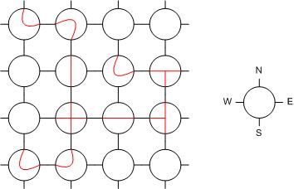
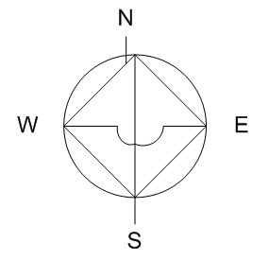
The Reconfigurable Mesh
2-dimensional processor array with reconfigurable bus system.
A set of 4-IO ports labeled N,E,S,W connect each PE to its 4 neighbors.
Each PE has locally controllable switches
→

Slide 20
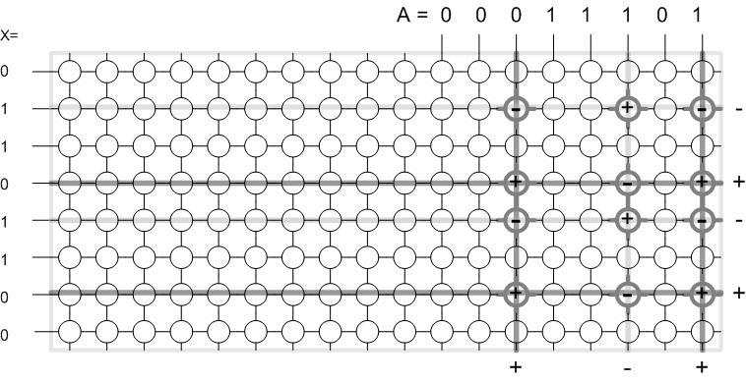
Reconfigurable Mesh (The Vector)

Slide 21
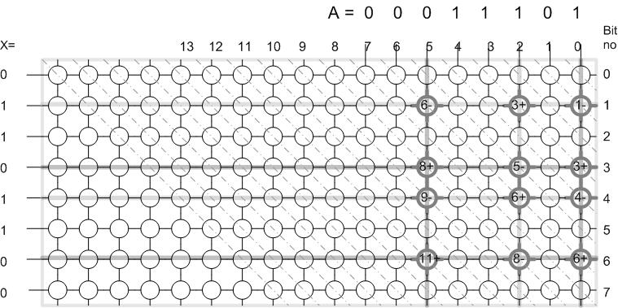
Reconfigurable Mesh (The Matrix)

Slide 22
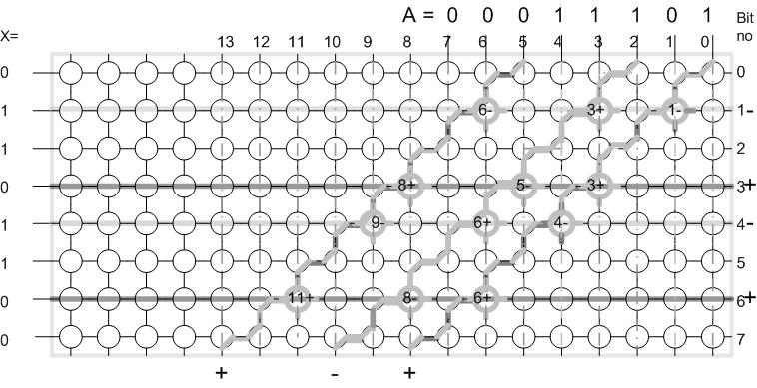
Reconfigurable Mesh (The Matrix)

Slide 23
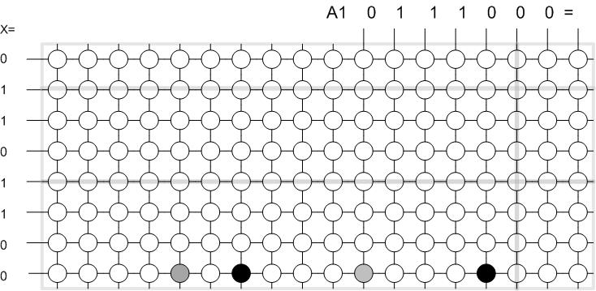
Reconfigurable Mesh (After Simplifications)

Slide 24
Relative improvement percentage per calculation group in a 16 bit scan

Slide 25

Thank you!!!

